Slide 1

Material Recovery Facilities (MRFs)

Slide 2
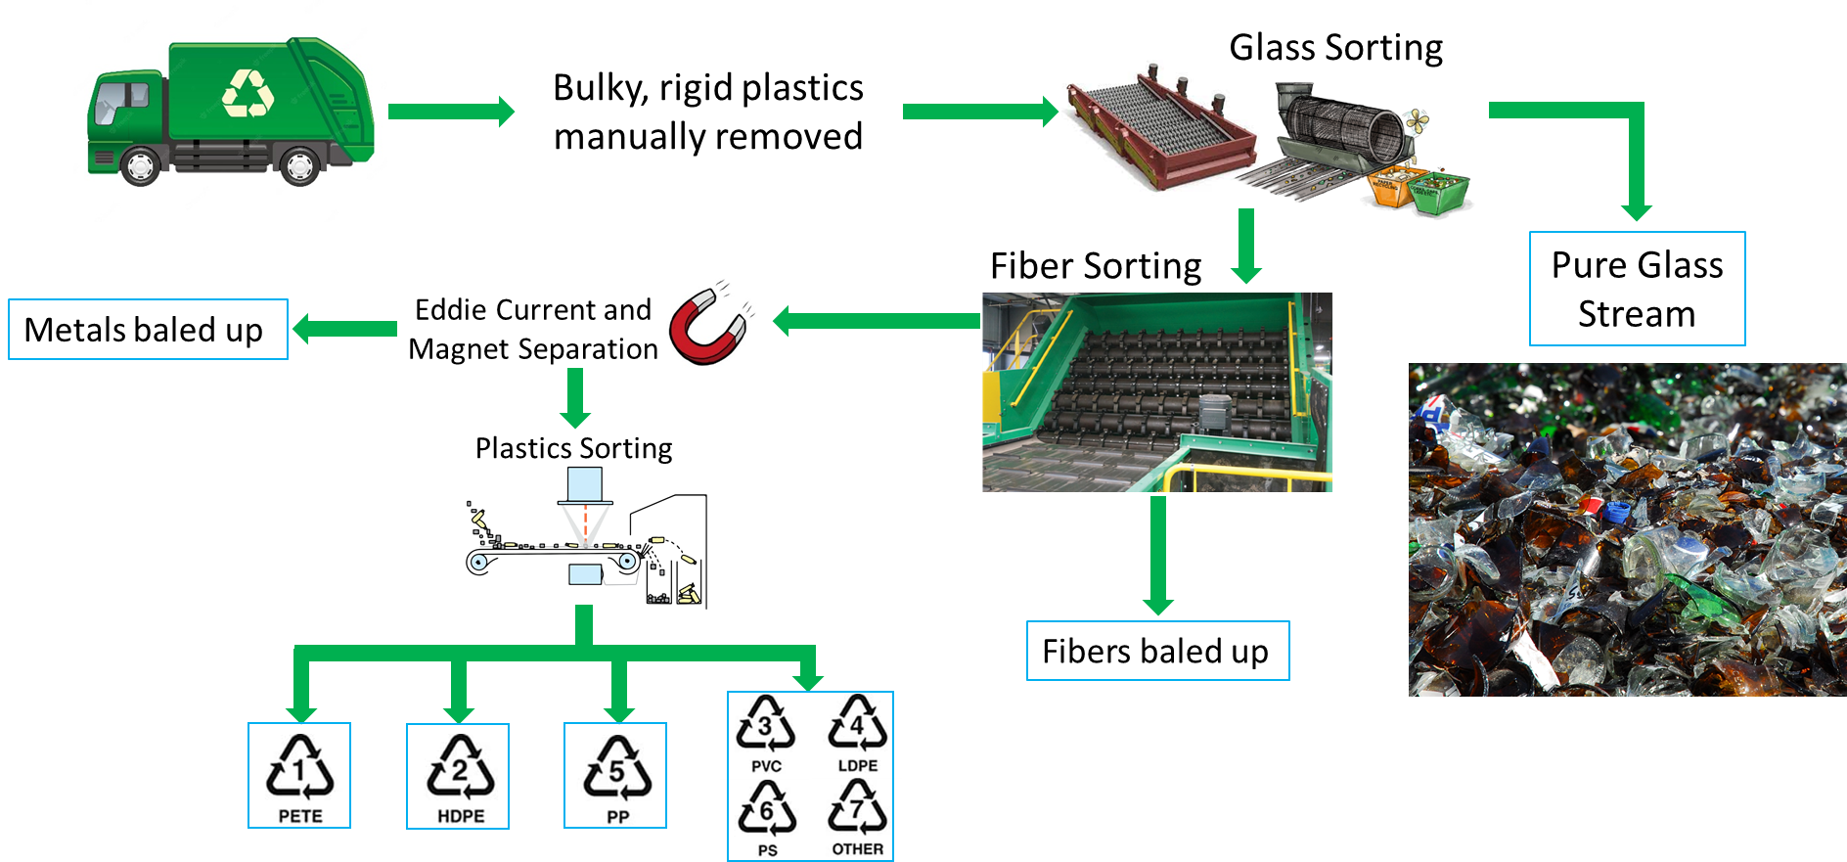
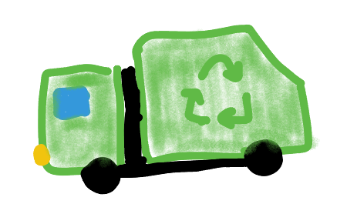
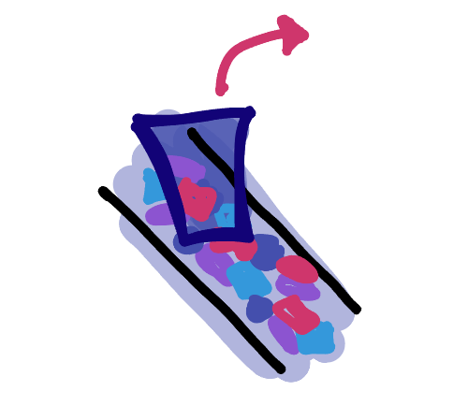
A look at a typical ‘automated’ MRF
Insert pic of recycling pickers in plant
Insert pic of recycling truck
Bulky, rigid items manually picked out
Recycling picked up

Slide 3
Glass and fiber sorted on lines
Glass sorting
Paper/fiber sorting
Insert pic of glass sorter
Insert pic of paper sorter
Pure glass stream
Insert pic of fiber bales
Insert pic of glass stream
Fiber bales

Slide 4
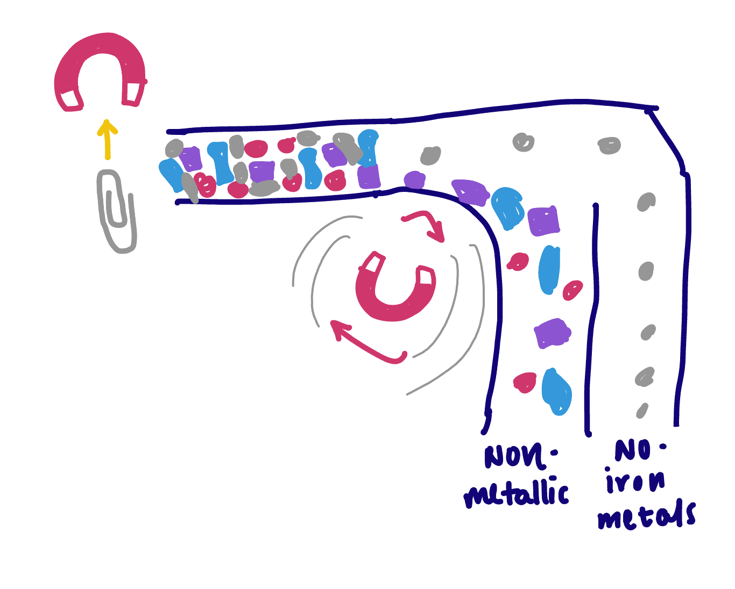
Metal pulled out with magnets
Eddy current and magnetic separation
Metal bales
Insert pic of metal bales

Slide 5

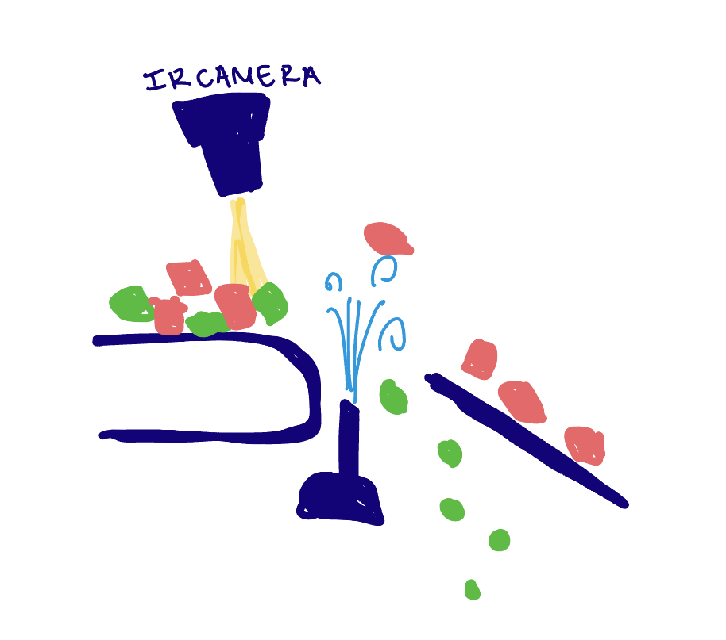
Plastics sorted by chemical identity
Plastics sorting
Not usually recyclable
https://possibility.teledyneimaging.com/planet-earth-or-planet-plastic/

Slide 6

Overview of process
Insert pic of glass sorter
Insert pic of glass stream
Insert pic of paper sorter
Insert pic of fiber bales
Insert pic of metal bales
https://possibility.teledyneimaging.com/planet-earth-or-planet-plastic/

Slide 7
Link do vídeo
https://youtu.be/7CFE5tD1CCI

